Slide 1
What is a Successful Software Project?
Dr. Dobb’s Journal 2013 IT Project Success Survey posted at
www.ambysoft.com/surveys/

Slide 2
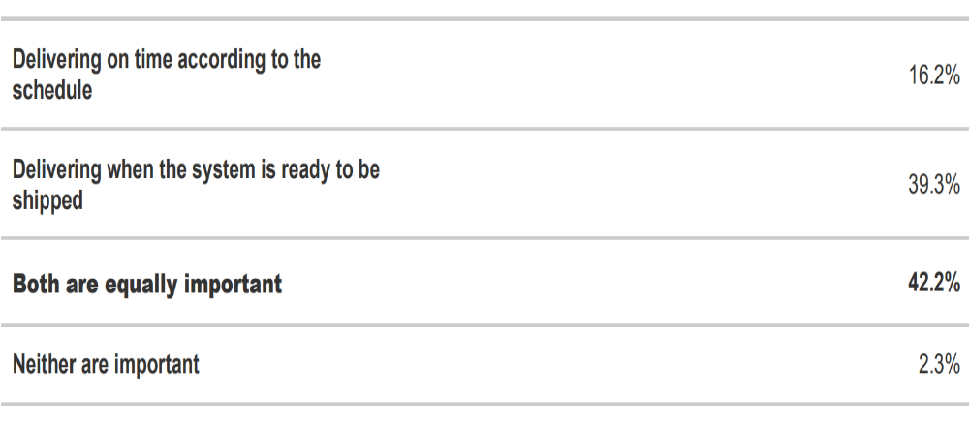
Time (deliver according to schedule vs. when the SW is ready to be shipped)

Slide 3
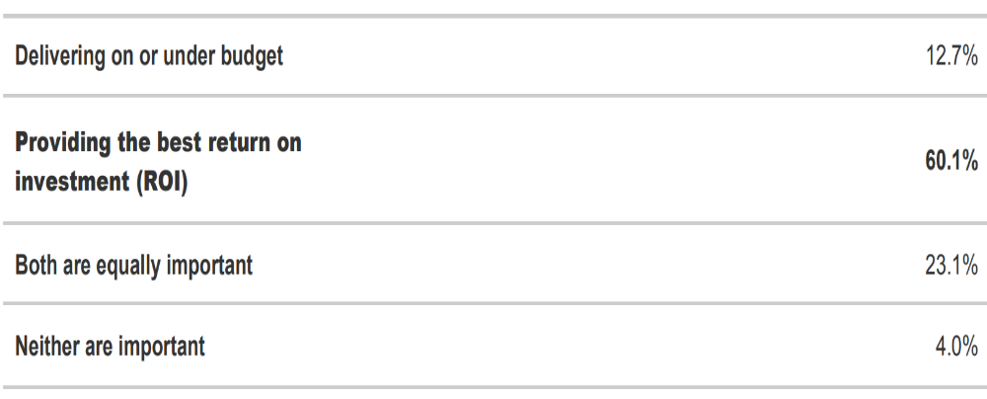
Money (deliver on or under budget vs. providing the best ROI)

Slide 4
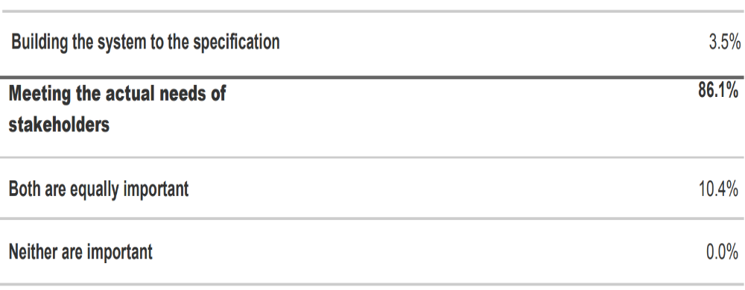
Value (Building to the Specs. vs. meeting the actual needs of stakeholders)

Slide 5
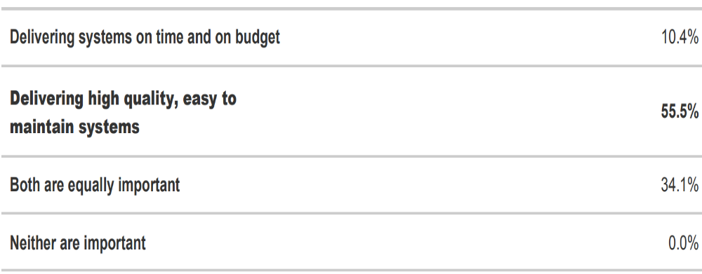
Quality (Delivering on time and on budget vs. high quality and maintainable system)

